Slide 1

Rockbuster Stealth
Data Analysis
Nhlonipho Mkhwane
12.08.2024

Slide 2

KEY QUESTIONS AND OBJECTIVES
Rockbuster Stealth LLC is a movie rental company that used to have stores around the world. Facing stiff competition from streaming services such as Netflix and Amazon Prime, the Rockbuster Stealth management team is planning to use its existing movie licenses to launch an online video rental service in order to stay competitive.
Which movies contributed the most/least to revenue gain?
What was the average rental duration for all videos?
Which countries are Rockbuster customers based in?
Where are customers with a high lifetime value based?
Do sales figures vary between geographic regions?

Slide 3
PERFORMANCE OVERVIEW
High-Level Key Performance Indicators
01
TOTAL REVENUE
04
TOTAL NUMBER OF CUSTOMERS
$63 312
599
02
TOTAL NUMBER OF FILMS
05
HIGHEST GROSSING COUNTRY
959
India
03
HIGHEST GROSSING CATEGORY
06
AVERAGE RENTAL DURATION
Sports
Five Days
Rockbuster Stealth is available in 108 countries

Slide 4
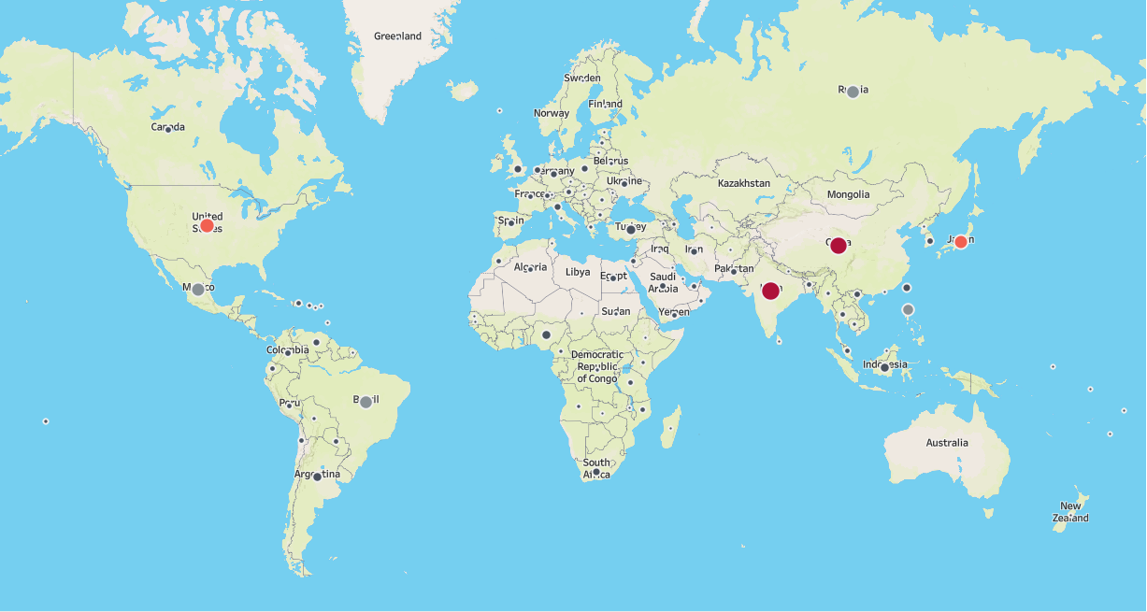
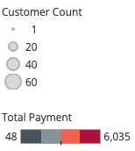
GLOBAL DISTRIBUTION
Rockbuster Stealth has 599 customers renting films from 108 countries across the globe.
India, China and USA generate the most revenue and have the highest customer base.

Slide 5
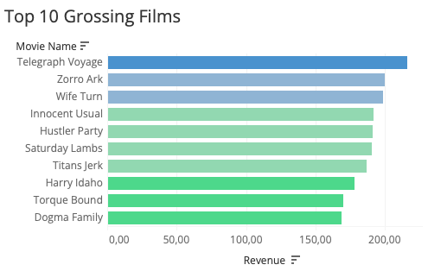
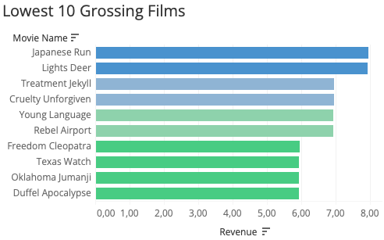
FILM PERFORMANCE
Rockbuster has close to 1 000 films available for rental to its customers. Other films perform better than others. The typical duration of rental is 5 days per movie.

Slide 6
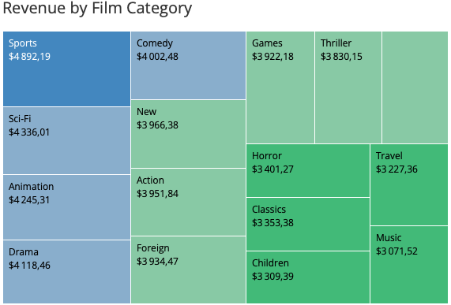
CATEGORY PERFORMANCE
The data suggests that the Sports category, followed by Sci-Fi and Animation are the most rented categories and generate the most revenue. Music and Travel, on the contrary do not perform that well.

Slide 7
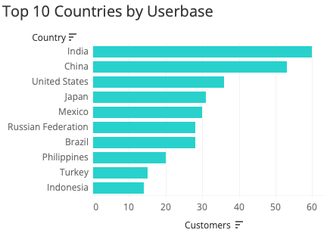
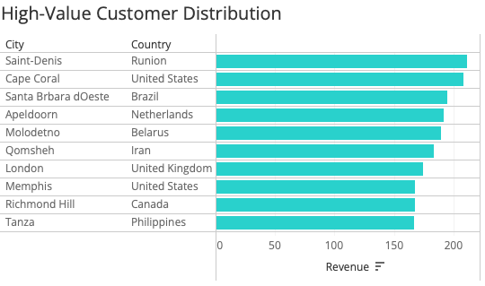
USERBASE VIEW
India, China and the United States have almost a third of the customer base account for 158 customers together. Other countries with a high number of customers are Japan and Mexico.
The high value customers come from across the world and these top 10 customers bring in about $1 844 altogether.

Slide 8
RECOMMENDATIONS
Highlight the best-performing film categories and review how the other categories that don't perform well, such as Music and Travel can be boosted.
Focus marketing on the bigger markets with the most customers and generate the most revenue.
Suggest also adding a reel on the platform that shows the "top 10 movies" or "most watched"
Consider removing films that don't perform well as this can reduce costs from licensing.

Slide 9
NEXT STEPS
Analyse the customer demographics and behaviour further to improve understanding of the base.
Conduct market research on customer likes and dislikes to improve film recommendations.
Consider an investment in AI tools to build a recommender which can also be used to boost the movies that don't perform well.
Consider other payment options and package options that could potentially appeal to a wider base.

Slide 10

QUESTIONS?
Follow this link to access the Tableau Dashboard

Slide 11
Rockbuster Stealth
Data Analysis
Thank You!

